Slide 1



GREEN UNIVERSITY OF BANGLADESH
Department of CSE
Course : Machine Learning Lab
CSE-404 | 231-D2
Presentation on
InsightCart
1

Slide 2
Presented by Presented to
|
Md. Shahed Shamim Rony
231902019
1
Ms. Mayeesha Farjana Lecturer
Dept. of CSE Green University of Bangladesh
1
Promod Chandra Das
231002005
1
Ashim Debnath
231902038
2

Slide 3
Table of Contents
01
02
Introduction and Problem Statement
Objectives
03
04
Dataset Overview and Preprocessing
Methodology - 9 Module Architecture
05
06
RFM Analysis Framework
Customer Segmentation Results
07
08
Machine Learning Model Performance
Association Rules (FP-Growth)
09
10
Anomaly Detection
Business Insights & Recommendations
3

Slide 4



Problem Statement & Proposed Solution
THE CHALLENGE
OUR SOLUTION
Retail businesses generate massive transaction data but struggle to extract actionable insights.
Comprehensive ML-powered analytics system with 9 integrated modules.
RFM-based customer segmentation
FP-Growth association rule mining
Anomaly detection & fraud prevention
Hidden purchasing patterns undiscovered
Fraudulent transactions undetected
No data-driven segmentation
1,067,371
686,764
5,675
Original Records
Clean Records
Customers
£8.8M
Revenue
4

Slide 5

Objectives
Analyze Transactions
Clean & Preprocess
Analyze large-scale retail transactions to extract actionable insights.
Perform robust cleaning and preprocessing for analysis reliability.
Customer Segmentation
Predictive Modeling
Implement RFM to segment customers for targeted strategies.
Train predictive models to forecast customer behavior and segments.
Association Rules
Fraud Detection
Mine association rules to surface cross-sell and bundling opportunities.
Detect anomalous/fraudulent transactions for risk mitigation.
Business Recommendations
Deliver data-driven business recommendations to boost revenue and retention.
5

Slide 6
Dataset Overview — Online Retail II
Key Attributes
Invoice
InvoiceDate
Transaction ID (6-digit)
Date and time
StockCode
Price
Product code (5-digit)
Unit price in GBP
Description
CustomerID
Product name
Unique 5-digit ID
Quantity
Country
Items per transaction
Customer location (41 countries)
1,067,371
686,764
5,675
Original Records
After Cleaning
Unique Customers
4,835
£8,825,609
Products
Total Revenue
6

Slide 7

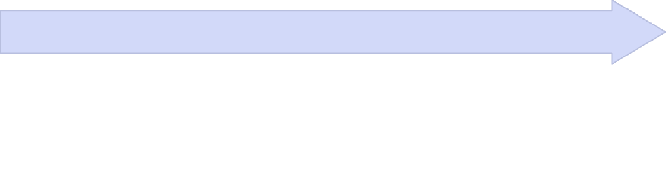

Methodology — 9-Module Architecture
A modular pipeline ensures reproducibility and clear responsibilities across the full workflow.
M2 — Feature Engineering
M1 — Data Preprocessing
TotalPrice, RFM metrics, and time features (Year, Month, DayOfWeek, IsWeekend).
Missing values, deduplication, outliers, and timestamp parsing.
M4 — Dimensionality Reduction
M3 — EDA
PCA applied for 2D visualization of RFM clusters and HighValue separation.
Explore patterns, distributions, and relationships in the data.
M6 — Clustering
M5 — FP-Growth
Group customers into segments with similar behaviors and value profiles.
Mine frequent itemsets and generate rules for cross-sell insights.
M8 — Ensemble Methods
M7 — Classification
Combine models to improve robustness and overall performance.
Predict labels or outcomes using supervised learning models.
M9 — Anomaly Detection
Flag unusual transactions, behaviors, and potential fraud signals.
7

Slide 8

RFM Analysis Framework
RFM metrics were computed and scored into quintiles (1–5).
Combined scores form segments: Champions (555), Loyal (454), At Risk (155), Lost (111), etc. Quintile scoring enables targeted actions per segment.
Recency
Frequency
Days since last purchase — average: 92 days
Average orders per customer: 4.3
Monetary
Average spend per customer: £1,555
8

Slide 9
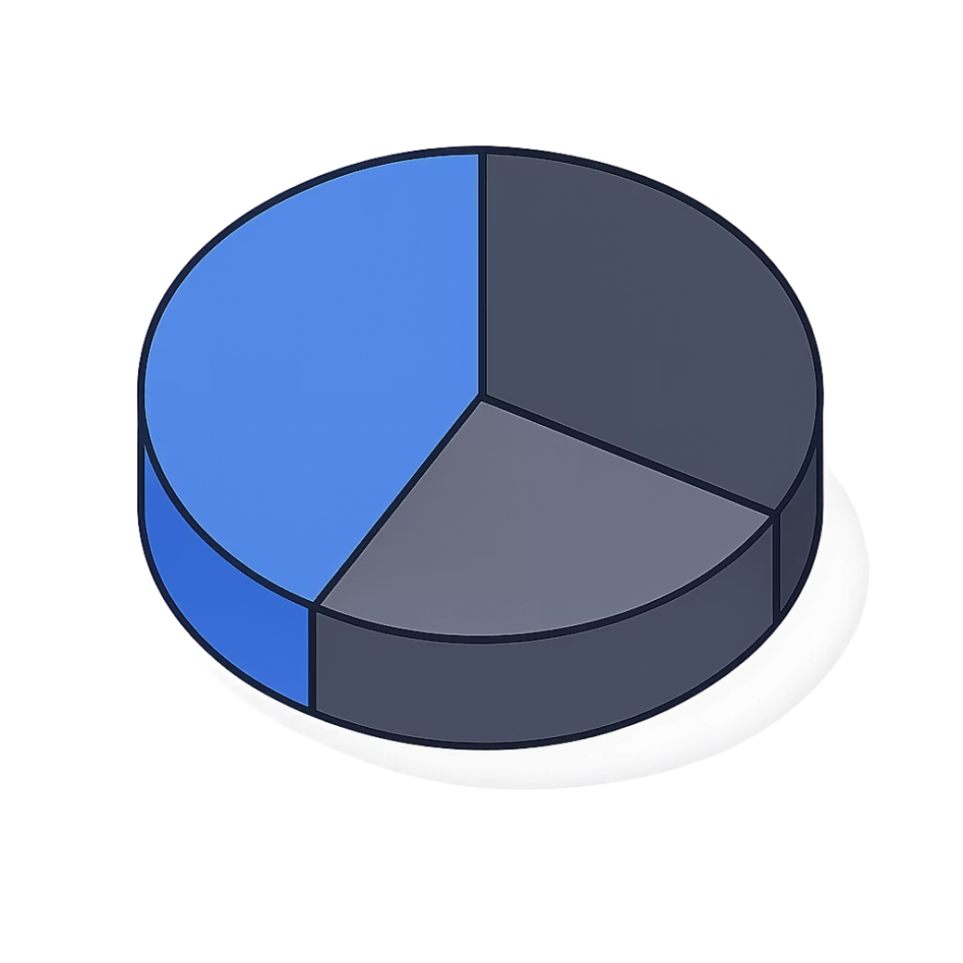
Customer Segmentation Results
Breakdown of 5,675 customers by 7 RFM segments. Key counts and strategic actions:
Champions (21.9%)
Loyal (19.2%)
1,240 customers
1,088 customers
Prioritize retention and VIP offers.
Drive upsell and loyalty programs.
Cannot Lose Them (10.4%)
Lost (21.2%)
590 customers
1,204 customers
Urgent win-back with exclusive high-value offers.
Run re-engagement campaigns.
At Risk (10.4%)
New (7.8%)
593 customers
445 customers
Launch targeted win-back efforts.
Focus on onboarding and welcome incentives.
9

Slide 10
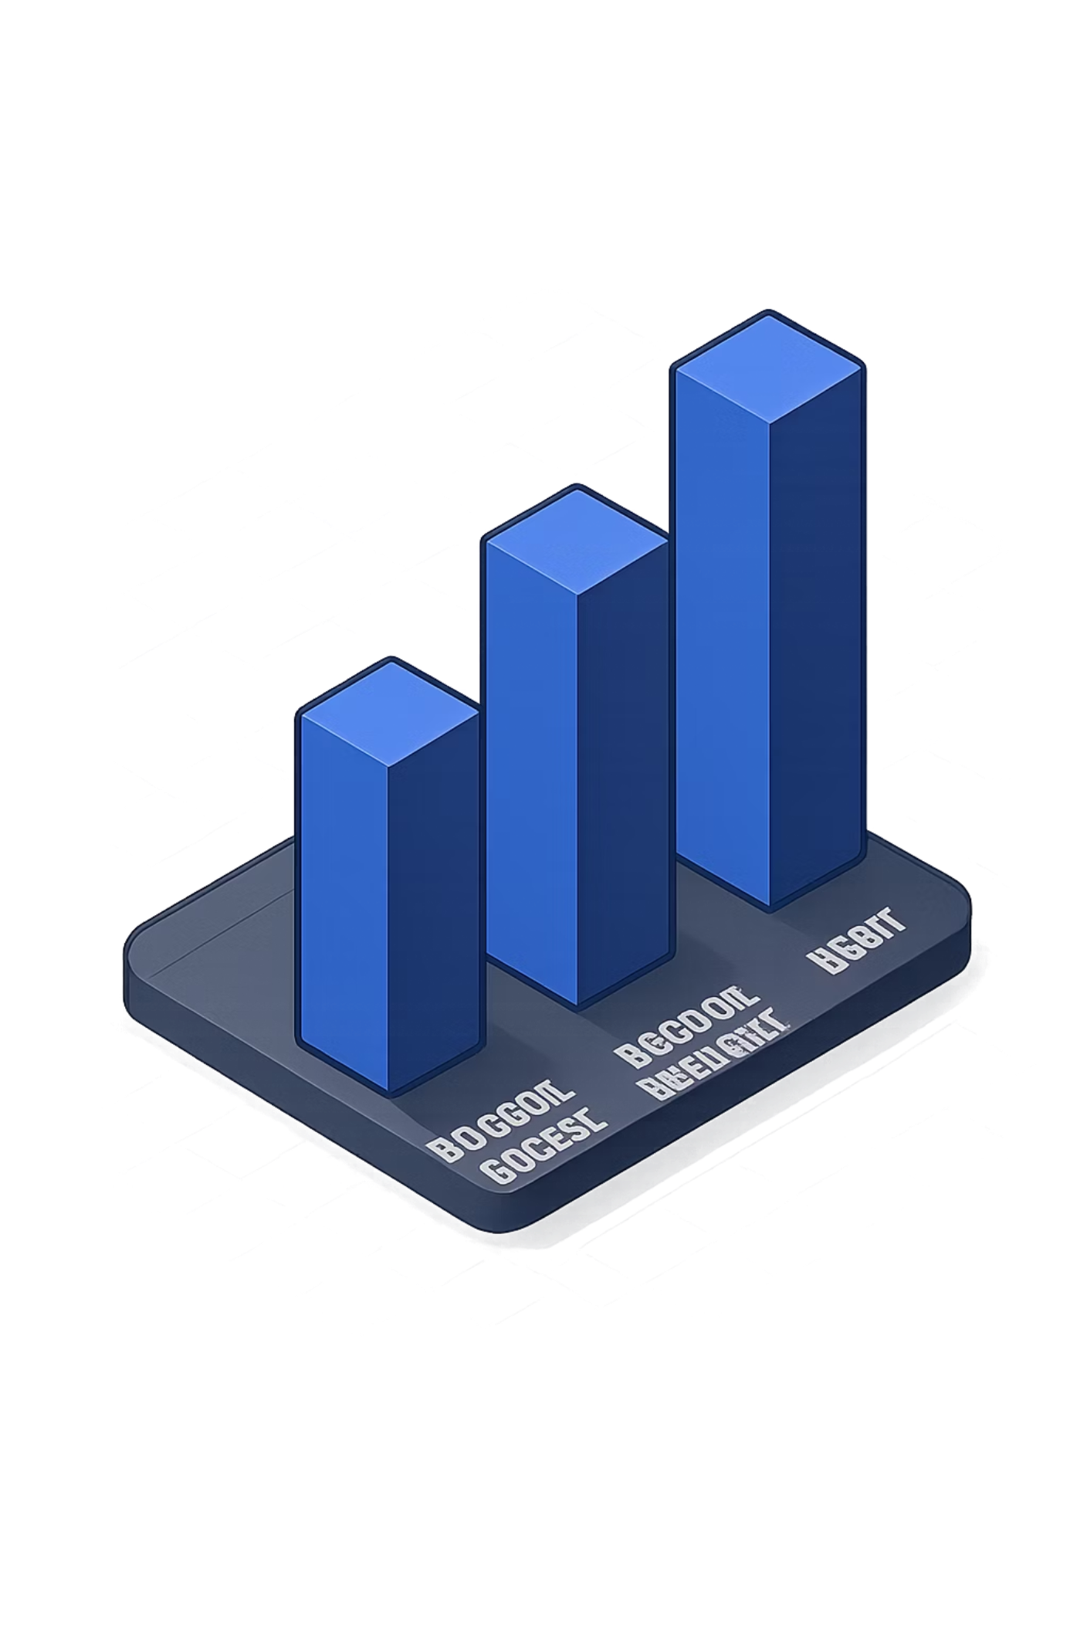

Machine Learning Model Performance
7 classifiers evaluated: Logistic Regression, Decision Tree, Random Forest, KNN, Naive Bayes, SVM, Gradient Boosting. Tree-based models achieved 100% accuracy. Ensemble methods (Bagging, AdaBoost, Stacking) also applied.
100%
98.1%
Tree Models
Logistic Regression · KNN · Naive Bayes
Decision Tree · Random Forest · Gradient Boost
98.0%
SVM · Bagging · AdaBoost · Stacking
Monetary value is the dominant predictor. Stacking (RF + SVM + KNN) achieved highest ensemble accuracy.
10

Slide 11
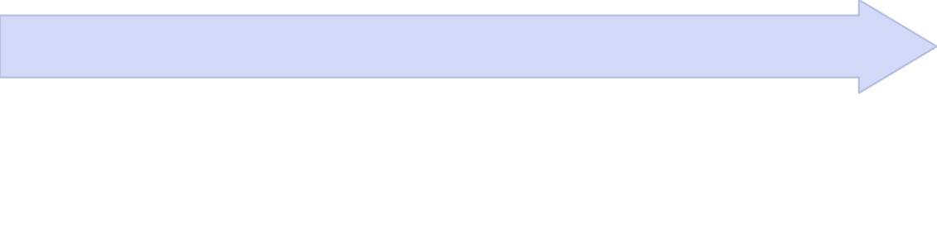


Association Rules — FP-Growth
FP-Growth was used to build an FP-Tree, mine conditional patterns, extract frequent itemsets, and generate association rules. Thresholds: min support 1%, min confidence 30%, min lift 1.5.
Association Rules
Conditional Patterns
Surface actionable product relationships
FP-Tree
Mine item combinations efficiently
Compactly organize transactions
Tea Cup → Tea Pot
Christmas Lights → Glass Ornaments
Lunch Bag → Water Bottle
Confidence: 78% · Lift: 4.2
Confidence: 65% · Lift: 3.8
Confidence: 52% · Lift: 2.9
Strong bundling candidate for paired promotions and complementary merchandising.
Seasonal cross-sell opportunity in Q4 and holiday display planning.
Consider bundled discounts for school and office buyers.
Rule
Confidence
Lift
Business Insight
Tea Cup → Tea Pot
78%
4.2
Best candidate for paired promotions; place products together to encourage add-on purchases.
Christmas Lights → Glass Ornaments
65%
3.8
Use in holiday bundles, seasonal endcaps, and Q4 campaign recommendations.
Lunch Bag → Water Bottle
52%
2.9
Bundle for back-to-school and commuter shoppers with targeted discounts.
Summary: Frequent itemsets mined at 1% support. Strong rules filtered at confidence ≥30% and lift ≥1.5. Prioritize high-lift rules for targeted promotions, cross-sell bundles, and product placement.
11

Slide 12

Anomaly Detection Results
ISOLATION FOREST
LOCAL OUTLIER FACTOR
Tree-based anomaly detection
Density-based detection
284
284
(5.0%)
(5.0%)
ANOMALY CHARACTERISTICS
Unusually high spending patterns
Extreme purchase frequency
Unusual buying behavior
Potential fraud indicators
Recommendation
Combined: customers flagged by BOTH methods — high-confidence anomalies. Manual review recommended.
12

Slide 13
Business Insights & Recommendations
CUSTOMER RETENTION
PRODUCT BUNDLING
TARGETED MARKETING
Focus on Champions & Loyal segments
Implement VIP loyalty programs
Personalized retention campaigns
Bundle often co-purchased items
Leverage high-lift association rules
Seasonal bundle promotions
Segment-specific campaigns
Personalized email marketing
Promotional sequences
FRAUD PREVENTION
INVENTORY OPTIMIZATION
REVENUE GROWTH
Monitor 284 flagged accounts
Automated alert systems
Regular review protocols
Stock high-demand items
Seasonal trend planning
Reduce overstock risk
Focus on high-value segments
Upsell & cross-sell strategy
Maximize customer lifetime value
13

Slide 14
Conclusion & Key Achievements
9
100%
7
5%
ML Modules
Model Accuracy
Customer Segments
Anomaly Rate
KEY ACHIEVEMENTS
Successfully processed 1M+ retail transactions with comprehensive data cleaning
Evaluated 7 classifiers + 3 ensemble methods; tree-based models achieved 100% accuracy
Identified 7 distinct RFM customer segments including “Cannot Lose Them” for targeted strategies
Mined strong association rules (confidence ≥30%, lift ≥1.5) for cross-sell and bundling
Detected 284 anomalous transactions for fraud prevention
14

